Slide 1

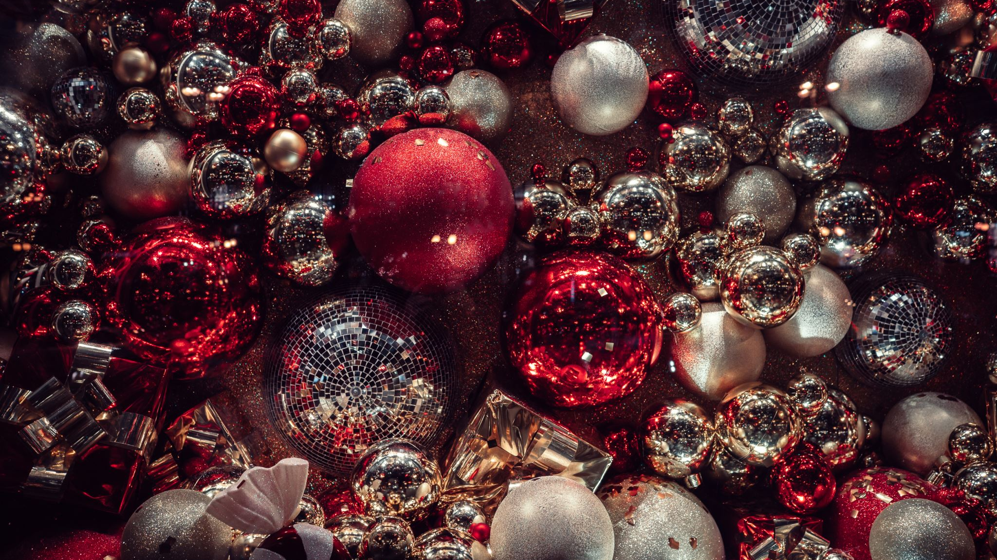
Christmas quiz at the queens head
Kingsnorth

Slide 2
Round 1
Christmas entertainment quiz

Slide 3
1. How old is Kevin McCallister in Home Alone?
Notes:
8 Years Old

Slide 4
2. In Will Ferrell’s Elf, what’s the first rule in the Code of The Elves?
Notes:
Treat everyday like Christmas

Slide 5
3. In which children’s classic is it ‘always winter but never Christmas’?
Notes:
CS Lewis' The Lion, The Witch And The Wardrobe

Slide 6
4. When Ross can’t find a Santa outfit in time for Christmas in Friends, what does he dress up as instead to impress his son Ben?
Notes:
Holiday Amadillo

Slide 7
5. In Love Actually, name the British boy band Billy Mack is competing against for Christmas Number One?
Notes:
Blue

Slide 8
6. What is the name of the little girl who befriends the Grinch in the 2000 film?
Notes:
Cindy Lou Who

Slide 9
7. Chris van Allsburg’s book The Polar Express was adapted into a festive film led by which Hollywood star?
Notes:
Tom Hanks

Slide 10
8. McFly’s Dougie Poynter and Tom Fletcher’s first-ever children’s book was a festive one about a dinosaur that did what?
Notes:
Popped Christmas

Slide 11
9. What’s the name of the giant snow monster that guards Elsa’s palace in Frozen?
Notes:
Marshmallow

Slide 12
10. Which TV family has a pet dog called Santa’s Little Helper?
Notes:
The Simpsons

Slide 13

Round 3 music round name the Christmas song

Slide 14

1 Christmas Reversed

Slide 15
2

Slide 16
1 Slade – I wish it could be Christmas everyday

Slide 17
Round 4 the picture quiz

Slide 18
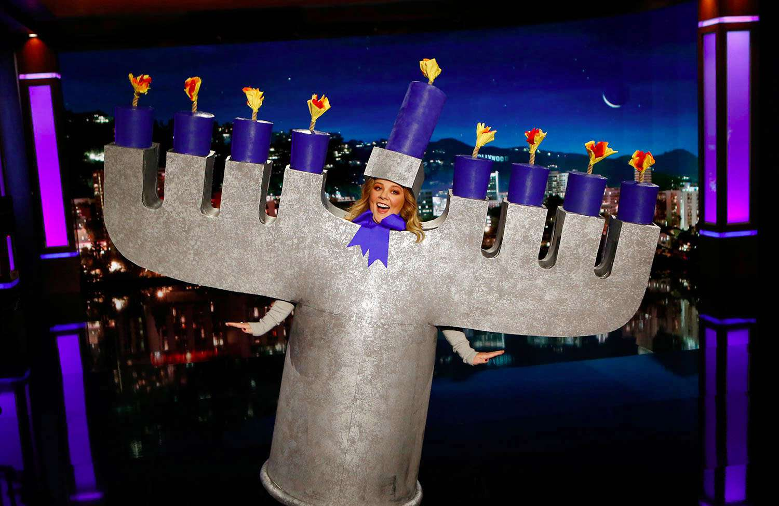
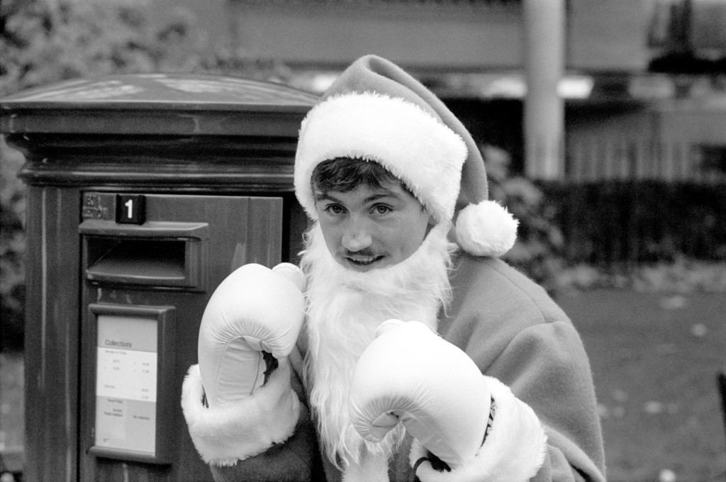
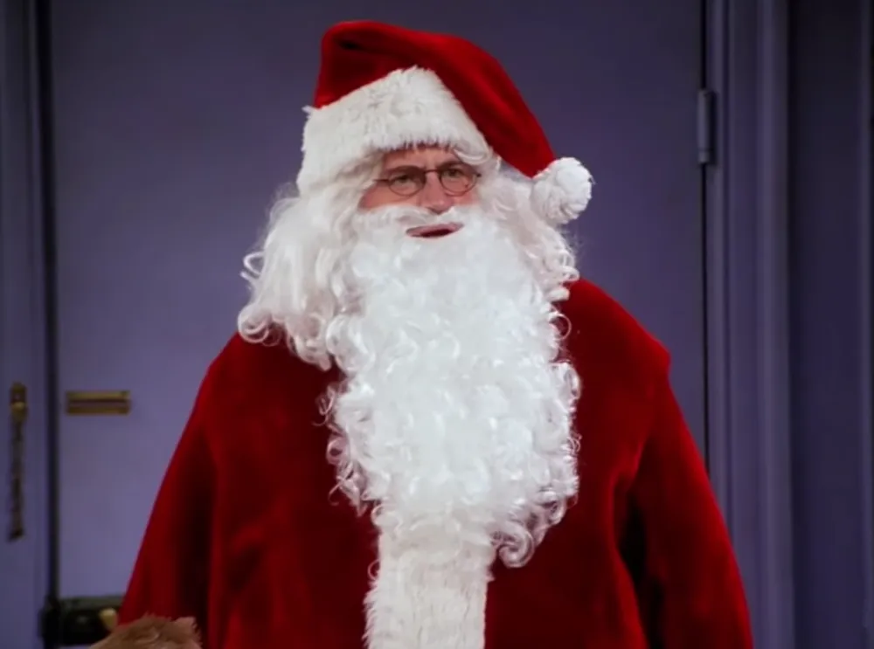
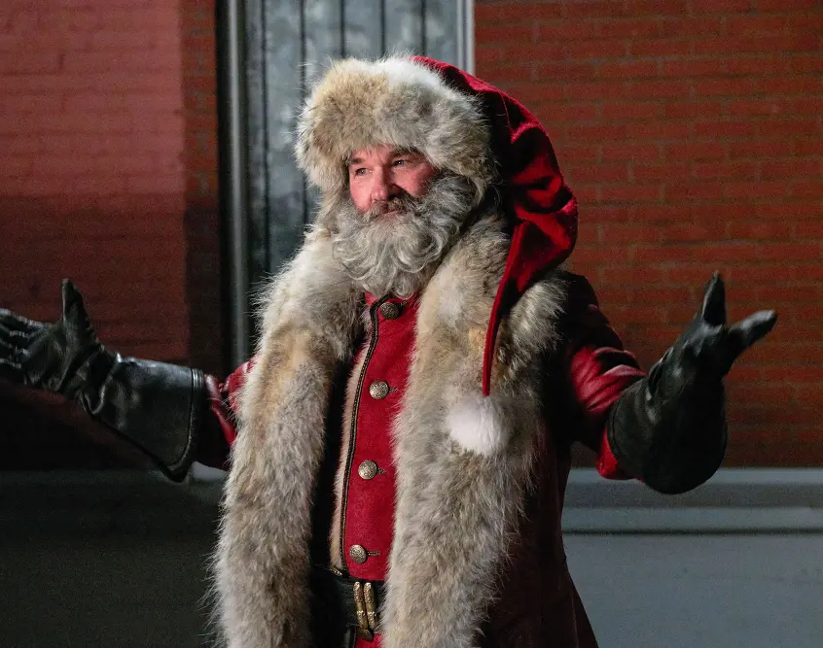
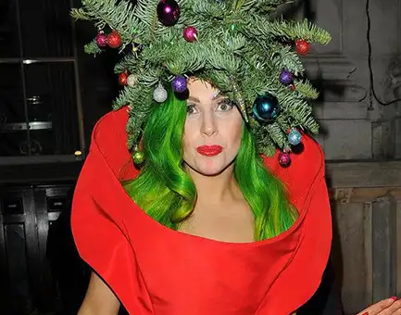
2
1
4
3
5
Notes:
1. Melissa McCarthy. 2. Barry McGuigan. 3. Kurt Russell. 4. Matthew Perry. 5. Lady Gaga

Slide 19
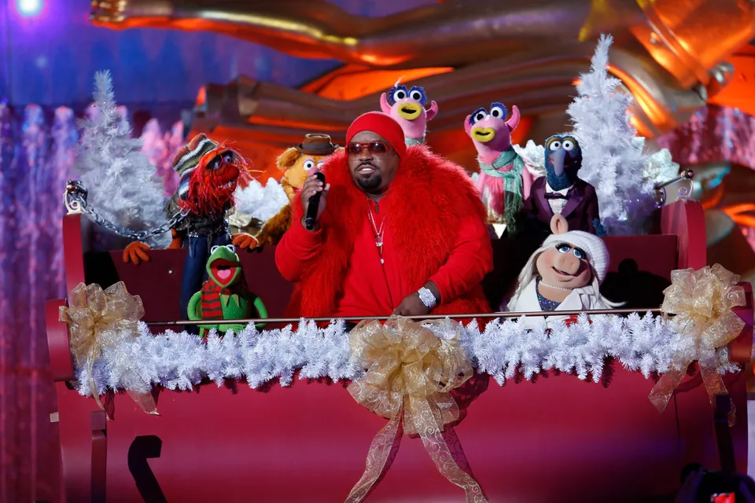
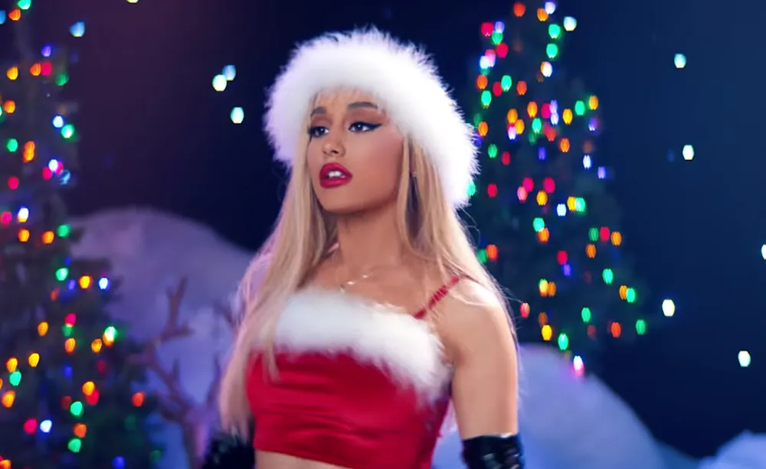
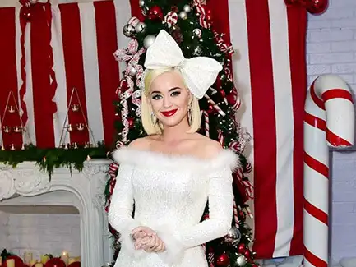
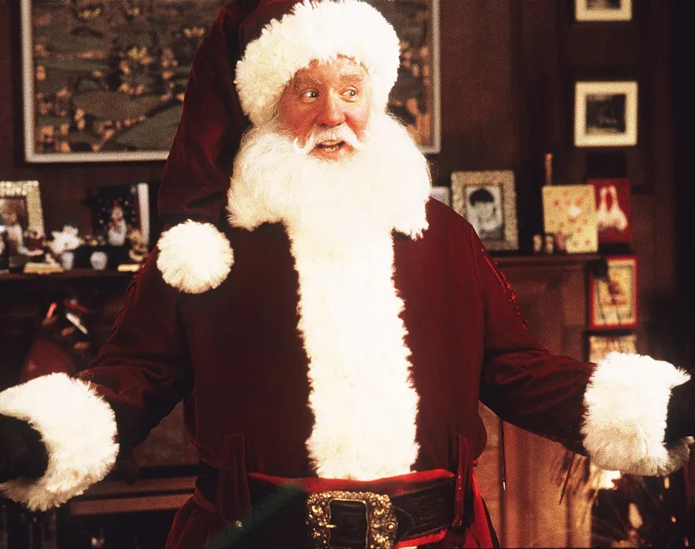
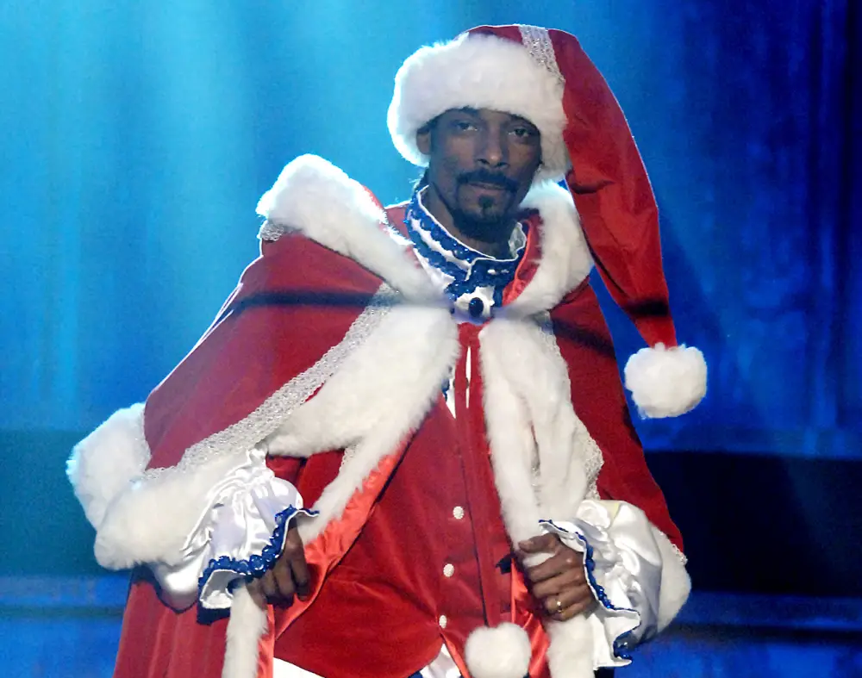
6
7
8
10
9
Notes:
6. Ceelo Green. 7. Ariana Grande. 8. Tim Allen. 9. Katy Perry. 10. Snoop Dogg

Slide 20

Round 5 the 1% Club

Slide 21
1
What three-word saying is hidden within this code? 3S46T89R5E7N68G46T5SH9
Notes:
Strength in Numbers

Slide 22
2
What number is missing from this sequence?
10, 20, 30, 50, 80, ? , 210, 340, 550
Notes:
130 Each number is the sum of the two numbers before it.

Slide 23
3
What two-letter word can be added to the end of these words to create another English word?
UNDER, FOR, MAN, CAR, TAN
Notes:
Add GO to the end of the word to create UNDERGO FORGO MANGO CARGO TANGO

Slide 24
4
What one letter is required to complete this 7 worded sentence?
*ig *a*ies *a**le in the *u**ly *athtu*
Notes:
B - BIG BABIES BABBLE IN THE BUBBLY BATHTUB

Slide 25
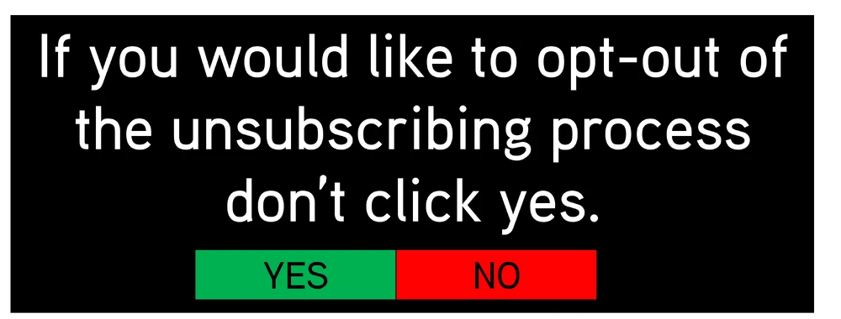
5
Which button do you click to unsubscribe from this email list?
Notes:
Don’t click YES to stop unsubscribing. So click YES to continue unsubscribing

Slide 26
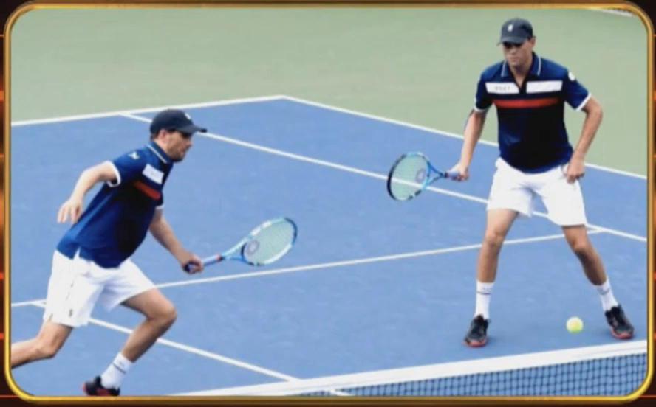
6
These tennis players are identical twins who always dress the same way on court, yet it is very easy to tell them apart. How?
Notes:
One is left-handed, one is right-handed.

Slide 27
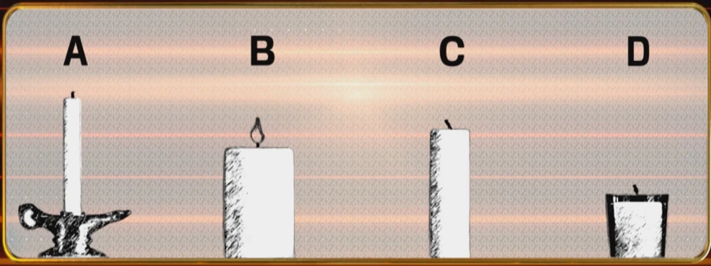
7
Take a good look at this picture. Which candle will burn down first?
Notes:
B - It is the only candle that is alight.

Slide 28
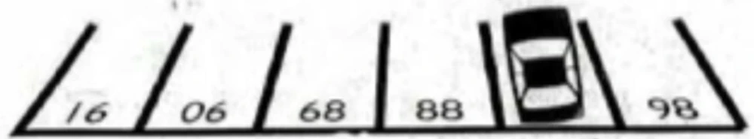
8
What is the car park number that the car is covering?
Notes:
87

Slide 29
9
Which legendary figure is written in code below?
HOROBOD
Notes:
Robin Hood

Slide 30

10
10. If you turn the blue cog clockwise, will the bucket go up or down?
Notes:
Down

